Slide 1
OLIST STORE ANALYSIS
Group No - 4

Slide 2
TEAM MEMBERS
Apoorva Upadhyay
1
Devata Jadhav
2
Swati Karanwar
3
Deeksha Patil
4

Slide 3
AGENDA
1
1
About the data
2
2
Importance of Olist store analysis
3
3
Key Performance Indicators (KPI’S)
4
Data Model
5
5
KPI 1 to 5
6
6
Screenshots of dashboards

Slide 4

ABOUT THE DATASET
The Dataset has information on 100000 orders form 2016 to 2018 made at multiple market places in Brazil. The orders include details such as order status, price, payment value, freight performance to customer location, product attribute, and reviews written by customers. The geolocation data is associated to Brazilian zip codes with latitude and longitude coordinates.
This is real commercial data, it has been anonymized , and references to the companies and partners in the review text have been replaced.

Slide 5
IMPORTANCE OF OLIST STORE ANALYSIS
Understand Customer Behavior
Identify areas for improvenent
Improving pricing
Olist store analysis can provide insights into customer behavior, such as payment preferences and review scores . this information can used to improve customer experience and increase customer loyality.
Olist store analysis can help identify areas for improvement , such as undelivered orders, by analyzing common themes in customer feedback.
Olist store analysis can help improve pricing strategies by ensuring that products are competitively priced.
Increase Profitability
Improve delivery
Retain customers
Olist store analysis can help increase profitability by identifying high profit margin categories and phasing out low margin products.
Olist store analysis can help improve delivery by identifying common themes in undelivered orders and communicating with customers about the delivery process.
Olist store analysis can help retain customers by identifying segments that are at risk of churning and implementing targeted retention strategies.

Slide 6
KEY PERFORMANCE INDICATORS (KPI’S)
Weekday vs weekend (order purchase timestamp) payment statistics
Total order = Weekend vs Weekday
Average payment value = Weekend vs Weekday
Total number of order with review score 5 and payment type as credit card
Average number of days taken for order delivered-customer _date for pet shop
Average price and payment values from customer of Sao Paulo city
Relationship between shipping days vs review scores
1 .1
1
2
3
4
5

Slide 7
KPI 1-WEEKDAY VS WEEKEND PAYMENT STATISTICS
TOTAL ORDERS = WEEKDAY VS WEEKEND

Slide 8
AVERAGE PAYMENT VALUE = WEEKDAY VS WEEKEND
Payment data according to weekend and weekday, which is very important as it allows businesses to make strategic plans.
Payment statistics is informing us of the weekend and weekday purchase timestamps. This means that the payment value used by the client on weekdays and weekends is the count of the payment value as per the weekend and weekdays as per this donut chart.
This KPI can help olist to improve their weekend sales and plans promotions.
The average payment value of weekday is 52 % and weekends is 48 %.

Slide 9
KPI 2 -TOTAL NUMBER OF ORDERS WITH REVIEW SCORE 5 & PAYMENT TYPE AS CREDIT CARD
The analysis shows that 76% of the total customers has used payment option as credit card.
Based on review scores customer has reviewed as 5 for around 44k (73399) transactions done via credit card.
If we combine count of review score 4 and 5 the 77% of the credit card users have given review score above 4 .
this means customers have been experiencing good experience while doing transaction via credit card.

Slide 10
KPI 3 - AVERAGE NUMBER OF DAYS TAKEN FOR ORDER DELIEVERED CUSTOMER DATE FOR PET SHOP
In this KPI we calculate average shipping days specifically for pet shop category.
Average calculation shows that shipping takes 11 to 13 days.
so , shipping days is important aspect for any business. as per calculation shipping days are more than expected.
Overall conclusion is that olist store should focus on reducing the shipping days.

Slide 11
KPI 4 - AVERAGE PRICE AND PAYMENT VALUE FROM CUSTOMERS OF SAO PAULO CITY
sao Paulo city is one of the most popular city of Brazil.
The Average price of sao Paulo city is 107 and Average payment value of this city is 151.
Accordingly, we can advise that this city is a profitable city to invest in.
Olist have correctly worked on its pricing strategy and need to focus more on bringing competitive prices to sustain in long run.

Slide 12
KPI 5 - RELATIONSHIP BETWEEN SHIPPING DAYS VS REVIEW SCORE
This KPI analyzes the relationship between shipping days and review scores.
It helps in understanding the impact of delivery time on customer satisfaction levels.
Olist can use this information to optimize their logistics and improve their delivery time.

Slide 13
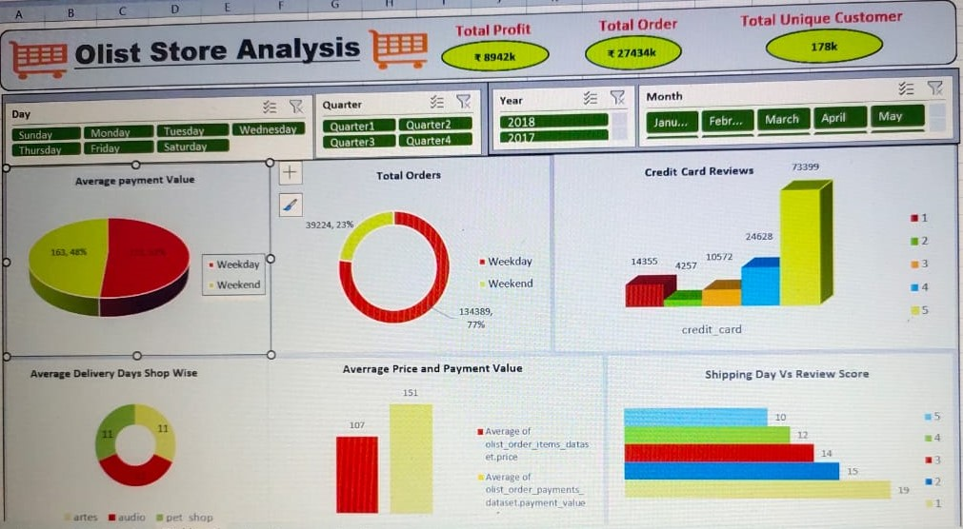
EXCEL DASHBOARD

Slide 14
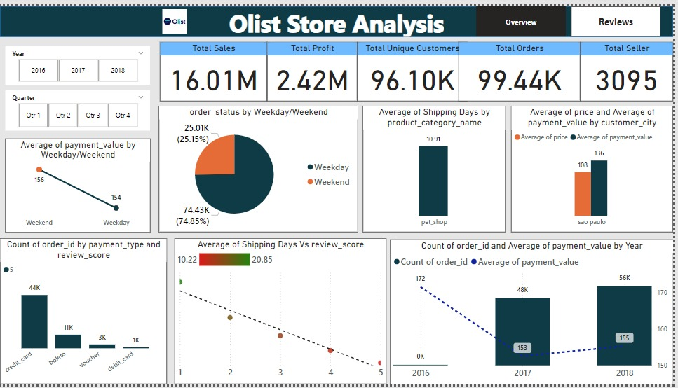
POWER BI DASHBOARD

Slide 15
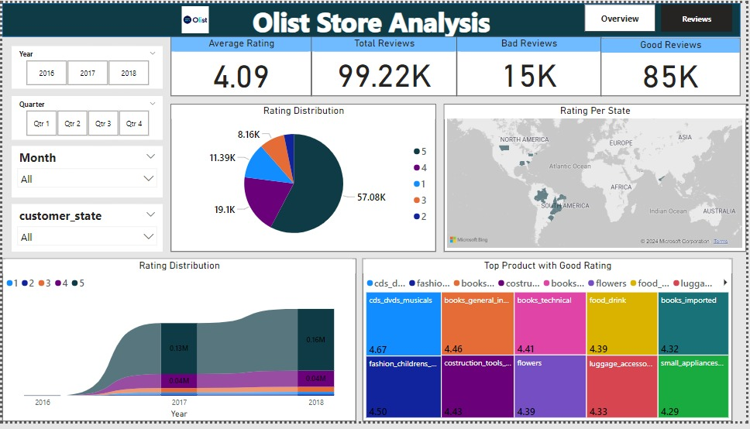
POWER BI DASHBOARD

Slide 16
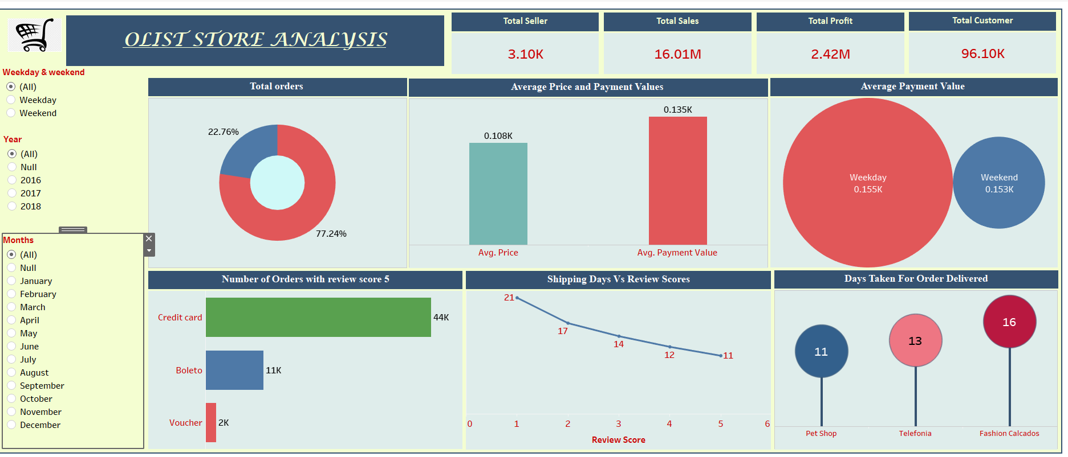
TABLEAU DASHBOARD

Slide 17
INSIGHTS
Insights from this analysis can help in marketing business decisions , such as focusing on products that customers are interested in, improving product and service quality , and optimizing marketing in provinces with high total sales .
In addition, this analysis also provides an overview of customer consumption trends and patterns that can be used to direct further business strategies.

Slide 18
RECOMMENDATIONS
Regularly monitor and analyze customer reviews to gain insights in product quality and identify areas for improvement . Dashboards can be used to identify customer patterns in customer reviews. This will provide a data driven approach to enhance customer experience.
Providing a proper shipment tracking system aids in having clear and concise communication between customers , sellers and couriers. Regular updates can set proper expectations among customers and specific delivery instructions of customers can be properly accommodated, By establishing trust and communication, both parties can work together to resolve any issues that may arise.

Slide 19
SUMMERY
Overall, regular monitoring of customer reviews, real time tracking of fleet performance, together with proper shipment tracking and communication system can improve Olist’s delivery and supply chain performance and ensure customers are highly satisfied with the service.

Slide 20
CONCLUSION
The Olist store analysis project provides valuable insights into customer behavior and payment statistics.
The analysis of this KPI’s helps Olist in identifying areas of improvement and creating targeted marketing campaigns. As a data analyst.
I have used Excel and Power BI to clean and manipulate the dataset and create meaningful visualizations.
This project serves as a great example of how data analysis can help businesses make informed decisions.

Slide 21
THANK YOU !!

